Slide 1
Advanced Programming Project Milestone 1
20202639
김 동 현

Slide 2
Progress
Rough design sketch
Which libraries to use
Akka
Akka-gRPC
Log4j
Process flow
FSM-like design
Minimal RPC implementation
Slaves can connect to master
Slaves can send some sampling results

Slide 3
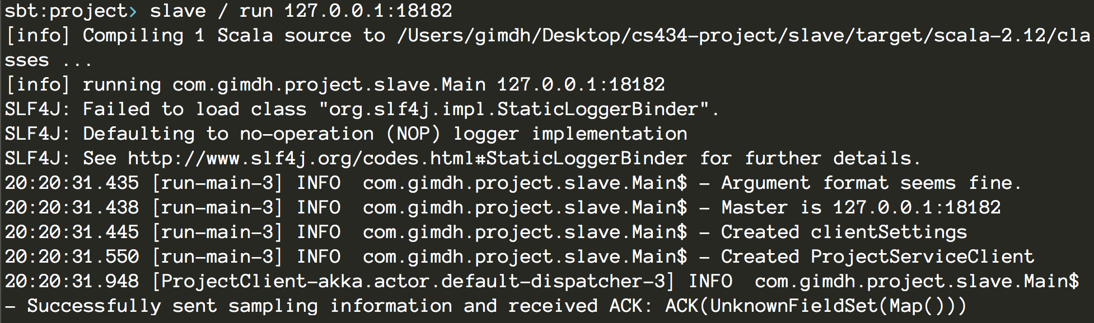
Execution example
Master
Slave

Slide 4
Execution guide
Master
./master [number_of_slaves]
Slave
./slave [address:port of master]
Current limitations
Master do not track slaves
Master only attaches to 127.0.0.1:18182 (Hard-coded)
Sampling data is yet to be implemented
Master cannot retrieve slaves’ address information from received message (Likely to be a library limitation)

Slide 5
Design scheme
3–Stage operation
1st - Sampling stage
Master collects slave address information and sampled data information
2nd – Local sorting stage
Slaves sort data locally
Slaves exchange data partitions
3rd – Global merge stage
Slaves merge final partitions
Master prints result

Slide 6
Design scheme (Sampling stage)
Master
Slave
Bind
Currently implemented
Send sample data
Collect slave info
Poll sampling completion
Collection complete
Send slaves’ info
Collect info

Slide 7
Design scheme (Local sorting stage)
Master
Slave
Sort local data
Partition data and exchange with other slaves (Akka TCP stream)
Notify local completion
Collect notifications
Poll global completion
Collection complete
Permit final merge
Receive permit

Slide 8
Design scheme (Global merge stage)
Master
Slave
Merge partitions
Report results
Collect results
Collection complete
Finished
Generate final report
Finished

Slide 9
Design decisions and reasonings
Why Akka?
By Lightbend (Formerly known as Typesafe)
Founded by Martin Odersky who also designed Scala
=> Should be the most ‘Scala-ish’ way of handling concurrent applications
Supports multiple backend under consistent actor model
Specifically gRPC and TCP
FSM model fits well with project
Why gRPC?
gRPC implements RPC with protocol buffer under the hood
Easy, well-documented
Efficient with HTTP/2 and compression
Why polling?
gRPC does not support calls from master, thus client should poll

Slide 10
Possible huddles
Akka-gRPC may not have grpc/peer frontend
Cannot retrieve client IP address from master
Could be complemented by including IP address in message
Akka Typed may restrict FSM architecture
Different messages should be exchanged for each different stages
May not be able to fully benefit from type-safety of Akka Typed
Mixing two protocols could be another synchronization challenge
gRPC is not appropriate for large file transfer (runs on HTTP/2 stack)
Delegating file transfer to TCP stream would be necessary
Could be tricky to define message between two actors

